Slide 1

Programming Fundamentals
By
Suhail Asghar
Dawood University Of Engineering & Technology Karachi

Slide 2
Course
Course Title: Programming Fundamentals
Course Code: CS-1101
Instructor: Dr Suhail Asghar
Credit Hours: 4 (3,1)
Semester: Fall 2025

Slide 3
Recommended Textbooks
Essentials of C Programming with Microsoft® Visual Studio® By Farzin Asadi · 2023
C With Ease With Uncompromised Quality By Dr. Srinivas Yadlapaty · 2025
Computer Programming in C for Beginners By Avelino J. Gonzalez · 2020
Introduction to Programming with C++, Liang, Y.D, 3rd edition

Slide 4
Course Structure
Lectures
Lab Manuals
Assignments
Class Involvement/Quizzes
Mini Project

Slide 5
Evaluation Criteria
Class
Lab
Assessment Type | Weightage (%)
Assignments | 5
Class Involvement | 10
Mini Project | 10
Mid Exams | 15
Sessional | 10
Final Exams | 50
Assessment Type | Weightage (%)
Task Performance | 10
Lab Manuals | 10
Sessional | 5
Final Exams | 25

Slide 6
Lecture 1
Programming?
High-Level and Low-Level Languages
Compiler vs. Interpreter

Slide 7
Programming
Programming refers to a technological process for telling a computer which tasks to perform in order to solve problems
These instructions are written in a programming language (like C, Python, or Java) that the computer can understand
Problem Solving → breaking a big problem into small steps and writing them as code
Program → the set of instructions you write
Programming Language → the medium you use to communicate with the computer

Slide 8
Simple POV
Imagine a computer as a very special kind of robot that only understands a language made of 0s and 1s, called machine language.
It's like its secret code!
Computers understand only machine language (0s and 1s)
Humans cannot easily think or speak in binary
High-level languages (C, Python, Java, etc.) are closer to English
Programmers write instructions in high-level languages
Compiler/Interpreter converts these instructions into machine code
Computer executes the machine code to perform tasks
These instructions are called code

Slide 9
High Level vs. Low Level Languages
Feature | High-Level Language | Low-Level Language
Readability | Easy (near English) | Hard (symbols/0s & 1s)
Examples | C, Python, Java | Assembly, Machine code
Portability | Portable (cross-platform) | Not portable
Translation | Compiler/Interpreter | Assembler (or none for binary)
Execution Speed | Slower (needs translation) | Faster (direct hardware)

Slide 10
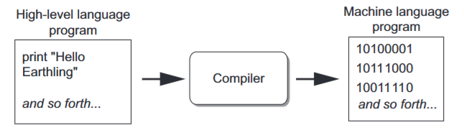
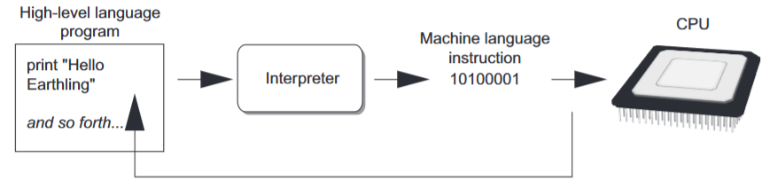
Interpreter (e.g., JavaScript, Python)
Its job is to read the instructions
It's like a patient teacher who reads the translated code (in machine language) to the computer one line at a time
It explains each instruction to the computer in a way it can understand, making sure it follows the steps correctly
Compiler (e.g., C, C++)
It works as a The Translator
It's like a super-smart language expert who takes our code and translates it into the computer's secret code (machine language)
It carefully reads every line of our code and makes sure it makes sense before translating it

Slide 11
How Programs Run?
Writing Code
Programmer writes instructions in a high-level language (C, Python, etc.)
Translation (Two Paths)
Path A: Compiler
Translates the entire program into machine code
Output: Executable file
Path B: Interpreter
Translates and executes line by line
Output: Immediate execution
Execution
The computer follows the translated instructions and performs the task

Slide 12
C
C is one of the foundational programming languages used in the development of compilers, operating systems, and embedded systems where speed and efficiency matter
Source Code (.c)
Expanded Source (.i)
Compiler
Assembly Code (.s)
Assembler
Object Code (.o)
Linker
Executable File (.exe/ a.out)
Run
Program Output

Slide 13
Compilation Process
1. Preprocessing
Handles directives like #include and #define
Expands macros, includes header files, removes comments
Output: A “clean” source code file (.i).
Example:
#include <stdio.h> // replaced with actual stdio.h content
#define PI 3.14 // every PI replaced with 3.14
2. Compilation
Converts the preprocessed code into assembly code (human-readable low-level instructions).
Output: Assembly file (.s)
3. Assembling
Assembler translates the assembly code into object code (machine code)
Output: Object file (.o or .obj)
4. Linking
Links object code with required libraries (like stdio.h functions)
Combines everything into a final executable file (.exe on Windows, a.out on Linux)
Execution
Run the executable file
The computer executes the machine code instructions and produces the desired output.

Slide 14

Popular C Compilers
GCC (GNU Compiler Collection)
Free, open-source, and widely used
Works on Linux, Windows (via MinGW), and macOS
Turbo C / Turbo C++
Very old, mostly for teaching in some schools
Runs mainly on DOS/Windows (no longer maintained)
Clang
Based on LLVM, modern and fast
Common in macOS and iOS development
MSVC (Microsoft Visual C++)
Microsoft’s compiler for Windows
Supports both C and C++
Usually comes bundled with Visual Studio IDE

Slide 15
What is MinGW?
MinGW stands for Minimalist GNU for Windows
Minimalist → A lightweight, minimal set of tools (not a full Unix environment)
GNU → Refers to the GNU Project, which develops free and open-source software, including the GCC (GNU Compiler Collection)
for Windows → It is specifically built to allow GNU tools (like GCC) to run natively on Windows
Originally, GCC meant GNU C Compiler (because it only supported the C language in the beginning). Later, as more languages were added, the name was changed to GNU Compiler Collection (GCC)

Slide 16
Popular C/C++ IDEs (Not Compilers)
Visual Studio (Windows)
Full-featured IDE by Microsoft
Uses MSVC as its default compiler
Code::Blocks
Free, cross-platform IDE
Uses GCC (via MinGW) as its compiler
Dev-C++
Lightweight IDE (older, less common today)
Typically uses GCC in the background

Slide 17
Integrated Development Environment
IDE, Integrated Development Environment is a single program that gives you all of the tools you need to write, execute, and test a program
Most IDEs Include:
Code Editor – for writing source code (with syntax highlighting)
Compiler/Interpreter – translates code into machine language
Debugger – helps find and fix errors
Build Automation – compiles and runs programs quickly
Project Management – organizes multiple source files.

Slide 18
An Example of C Program
#include <stdio.h> // Header file for input/output
int main() {
// Display a message
printf(“Hello DUET!\n”);
return 0; // End of program
}
#include <stdio.h> → Adds standard input/output library
int main() → Starting point of every C program
printf() → Prints text on the screen
return 0; → Ends the program successfully.

Slide 19
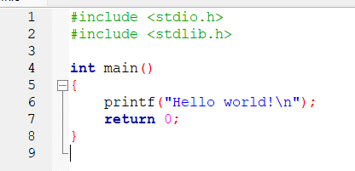

Slide 20
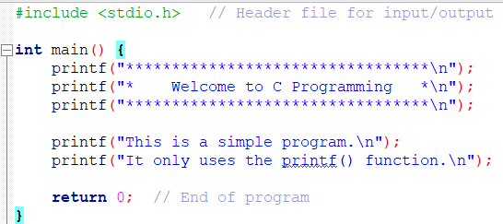
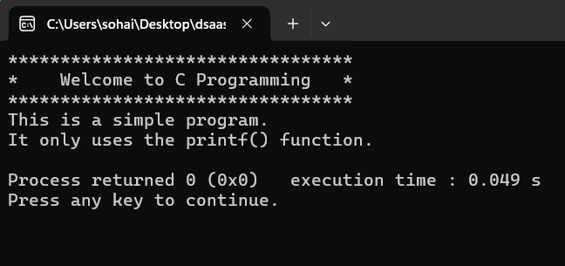
Cont.
Code
Output

Slide 21
Lecture 2
Programming Errors
Special symbols in C
Identifier in C
Data types

Slide 22
Programming Errors
Programming errors can be categorized into three types: syntax errors, runtime errors, and logic errors
Syntax Errors
Errors that are detected by the compiler are called syntax errors or compile errors
Syntax errors result from errors in code construction, such as mistyping a keyword, omitting necessary punctuation, or using an opening brace without a corresponding closing brace
#include <stdio.h>
int main() {
printf(Welcome);
return 0;
}
Missing Quotation marks
printf(wow)
Misspelling Names
C++ is case-sensitive. Misspelling names is a common error made by new programmers
For example, the word main is misspelled as Main in the following code
Int Main, int Main, PRINTF, Scanf

Slide 23
Programming Errors
2. Runtime Errors
Runtime errors cause a program to terminate abnormally
They occur while an application is running if the environment detects an operation that is impossible to carry out
Input mistakes typically cause runtime errors
Another common source of runtime errors is division by zero.
#include <stdio.h>
int main() {
int a = 10;
int b = 10/0;
printf("values is %d", b);
return 0;
}

Slide 24
Programming Errors
3. Logic Errors
Logic errors occur when a program does not perform the way it was intended
Errors of this kind occur for many different reasons
#include <stdio.h>
int main() {
int num1 = 10, num2 = 5, result;
// Logic error: programmer intended to add but used '-' instead
result = num1 - num2;
printf("The sum is: %d\n", result);
return 0;
}

Slide 25
Identifiers in C
In C programming, identifiers are the names used to identify variables, functions, arrays, structures, or any other user-defined items
It is a name that uniquely identifies a program element and can be used to refer to it later in the program
C is case-sensitive
A ≠ a
Identifiers need to be self-descriptive
Bad identifier
int x; // Not clear what x means
Good identifier
int studentAge; // Clearly shows this variable stores student's age
float circleArea; // Clearly shows this variable stores area of a circle

Slide 26
Identifier
Identifiers must be unique
Identifier must start with a letter or underscore, and be followed by zero or more letters (A-Z, a-z), digits (0-9), or underscores
Identifiers cannot be reserved words (keywords) ; double, main, return, if, while etc.
VALID
name_of_student
_class_student
Myage
myAge
INVALID
name#
2000Myage
My-Age
main

Slide 27
Special Symbols in C
Symbol | Meaning / Use
# | Preprocessor directive (used before commands like #include <stdio.h>)
; | Statement terminator (marks the end of a C statement)
& | Address-of Operator (Returns the memory address of a variable)
% | Format specifier (used in functions like printf and scanf to represent data type)
{ } | Braces: used to group multiple statements into a block (e.g., in main() or loops)
( ) | Parentheses: used in function calls and to control order of operations
" " | Double quotes: used for string constants (e.g., "Hello")
// | Single-line comment (ignored by compiler)
/* */ | Multi-line comment (ignored by compiler)
/n | Ends the line

Slide 28
&
& — Address-of Operator
& has two main uses in C:
(a) Address-of Operator
Returns the memory address of a variable.
Usage: &variable
#include <stdio.h>
int main() {
int x = 5;
printf("Address of x: %d\n", &x); // Output: memory address
return 0;
}
Explanation: &x gives the location in memory where x is stored.

Slide 29
% in printf
% is a format specifier used in functions like printf and scanf to represent data type of values
In printf, %d tells printf to print an integer in decimal (base 10) format
#include <stdio.h>
int main() {
int num = 42;
printf("The number is %d\n", num); // Output: The number is 42
return 0;
}
Here, %d is replaced by the value of num.

Slide 30
% in scanf
%d tells scanf to read an integer from user input.
Important: When using scanf, you need the address-of operator & because scanf needs to know where to store the input in memory
#include <stdio.h>
int main() {
int num;
printf("Enter a number: ");
scanf("%d", &num); // &num is needed to store the input in variable
printf("You entered %d\n", num);
return 0;
}

Slide 31
Reading Input from keyboard and Print
You can use the scanf object to read input from the keyboard
Scan int: scanf("%d", &var);
Scan float: scanf("%f", &var);
Scan double: scanf("%lf", &var);
Scan char: scanf("%c", &ch);
You can use printf object to print anything on console
Print int: printf("%d", var);
Print float: printf("%f", var);
Print double: printf("%lf", var);
Print char: printf("%c", ch);

Slide 32
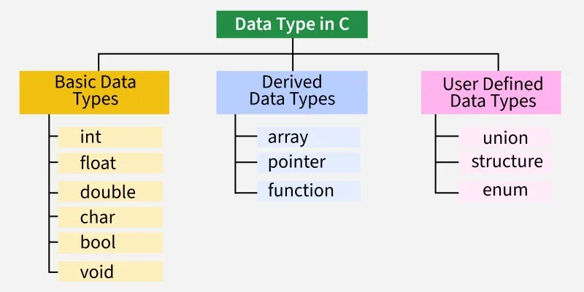
Data Types
Each variable in C has an associated data type
It specifies the type of data that the variable can store like integer, character, floating, double, etc.
Example:
int number; //The statement declares a variable with name number that can store integer values
C is a statically type language where each variable's type must be specified at the declaration and once specified, it cannot be changed.

Slide 33
Basic Data Types
Data Type | Description | Example
int | Stores integers (whole numbers) | int age = 21;
float | Stores real numbers with decimal (single precision) | float price = 10.5;
double | Stores real numbers with higher precision (double precision) | double pi = 3.14159;
char | Stores a single character | char grade = 'A';

Slide 34
Derived Data Types
Data Type | Description | Example
Array | Collection of elements of same type | int marks[5];
Pointer | Stores memory address of another variable | int *p;
Structure | Groups different types under one name | struct Student {int id; char name[20];};
Union | Like structure but shares memory | union Data {int i; float f;};

Slide 35
Enumeration Data Type
Data Type | Description | Example
enum | User-defined type for a set of named constants | enum Days {Mon, Tue, Wed};
Void Data Type
Data Type | Description | Example
void | Represents no value (used in functions with no return type) | void display();

Slide 36
Integer Data Types
Data Type | Size (Bytes) | Range
short int / short | 2 | 2^16 | -32,768 to 32,767
unsigned short int | 2 | 2^16 | 0 to 65,535
int | 4 | 2^32 | -2,147,483,648 to 2,147,483,647
unsigned int | 4 | 2^32 | 0 to 4,294,967,295
long int / long | 4 | 2^32 | -2,147,483,648 to 2,147,483,647
unsigned long int | 4 | 2^32 | 0 to 4,294,967,295
long long int | 8 | 2^64 | -9,223,372,036,854,775,808 to 9,223,372,036,854,775,807
unsigned long long | 8 | 2^64 | 0 to 18,446,744,073,709,551,615

Slide 37
Floating Data Types
Data Type | Size (Bytes) | Approximate Range | Precision
float | 4 | 3.4E-38 to 3.4E+38 | ~6 decimal places
double | 8 | 1.7E-308 to 1.7E+308 | ~15 decimal places
long double | 10 (sometimes 12/16 depending on compiler) | 3.4E-4932 to 1.1E+4932 | ~19 decimal places

Slide 38
Examples of C++ Data Values
int sample values
4578 -4578 0
bool values
true false
float sample values
95.274 95.0 .265
char sample values
‘B’ ‘d’ ‘4’ ‘?’ ‘*’

Slide 39
ASCII Table
Dec–Char | Dec–Char | Dec–Char | Dec–Char | Dec–Char | Dec–Char | Dec–Char | Dec–Char | Dec–Char | Dec–Char
32 (space) | 42 * | 52 4 | 62 > | 72 H | 82 R | 92 \ | 102 f | 112 p | 122 z
33 ! | 43 + | 53 5 | 63 ? | 73 I | 83 S | 93 ] | 103 g | 113 q | 123 {
34 " | 44 , | 54 6 | 64 @ | 74 J | 84 T | 94 ^ | 104 h | 114 r | 124 |
35 # | 45 - | 55 7 | 65 A | 75 K | 85 U | 95 _ | 105 I | 115 s | 125 }
36 $ | 46 . | 56 8 | 66 B | 76 L | 86 V | 96 ` | 106 j | 116 t | 126 ~
37 % | 47 / | 57 9 | 67 C | 77 M | 87 W | 97 a | 107 k | 117 u | 127 DEL
38 & | 48 0 | 58 : | 68 D | 78 N | 88 X | 98 b | 108 l | 118 v
39 ' | 49 1 | 59 ; | 69 E | 79 O | 89 Y | 99 c | 109 m | 119 w
40 ( | 50 2 | 60 < | 70 F | 80 P | 90 Z | 100 d | 110 n | 120 x
41 ) | 51 3 | 61 = | 71 G | 81 Q | 91 [ | 101 e | 111 o | 121 y
Decimal (Dec) → Base-10 numbers normally used (e.g., 65)
Hexadecimal (Hex) → Base-16 numbers often used in programming (e.g., 0x41)
Octal (Oct) → Base-8 numbers (e.g., 0101)
Binary (Bin) → Base-2 numbers (e.g., 01000001)

